Slide 1

SMART INDIA HACKATHON 2026
TITLE PAGE
Problem Statement ID- SIH26131
Problem Statement Title-Detection and Management of Crop Diseases and Pest Infestations.
Theme- Agriculture, Food Tech and Rural Development.
PS Category- Software
Team Valencia

Slide 2


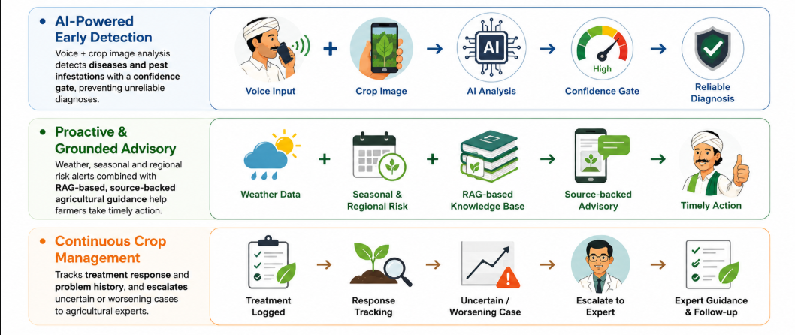
BHOOMI A voice-first, multimodal AI companion for continuous crop health monitoring
Proposed Solution

Slide 3
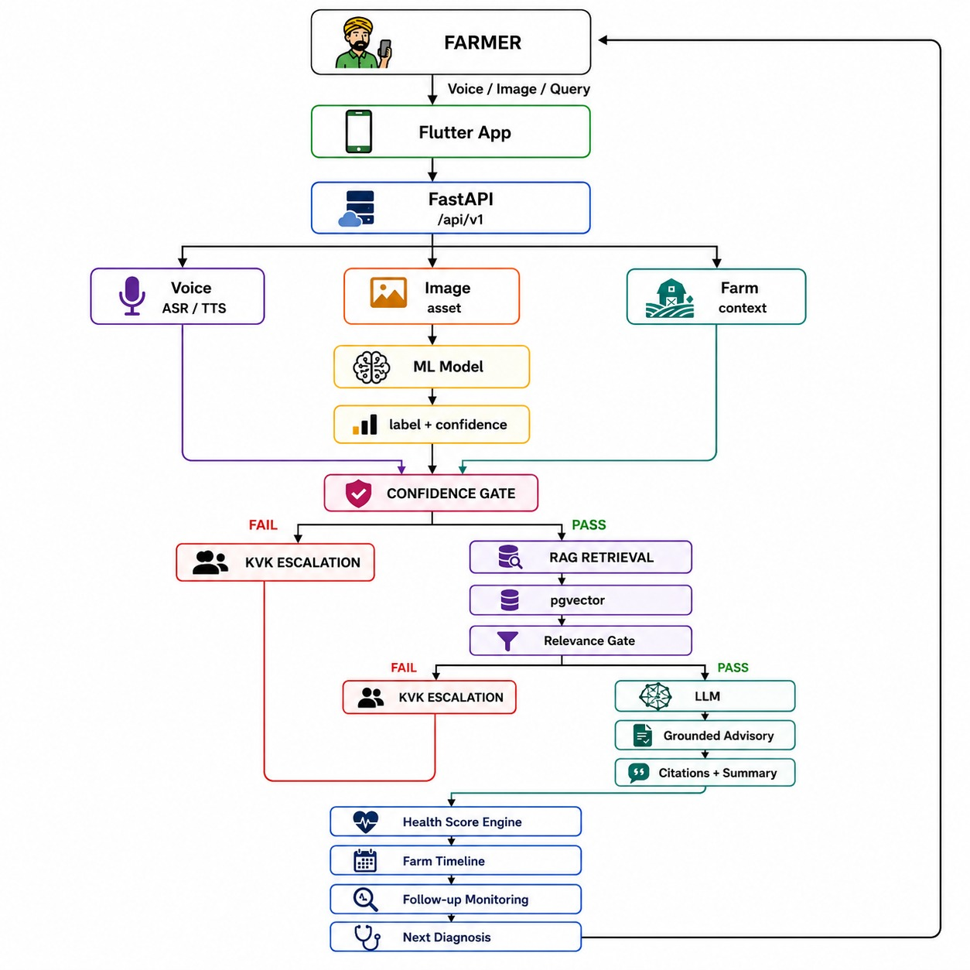
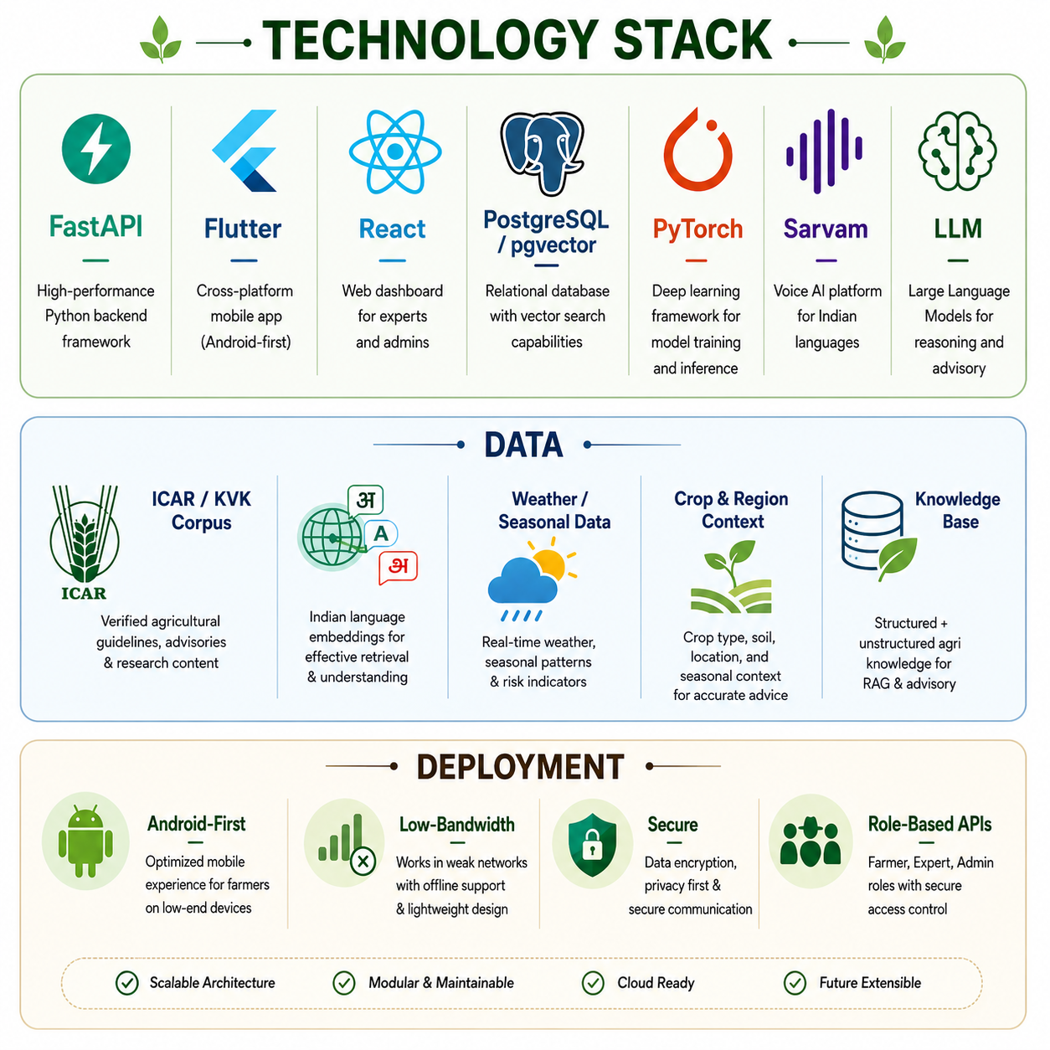
TECHNICAL APPROACH

Slide 4
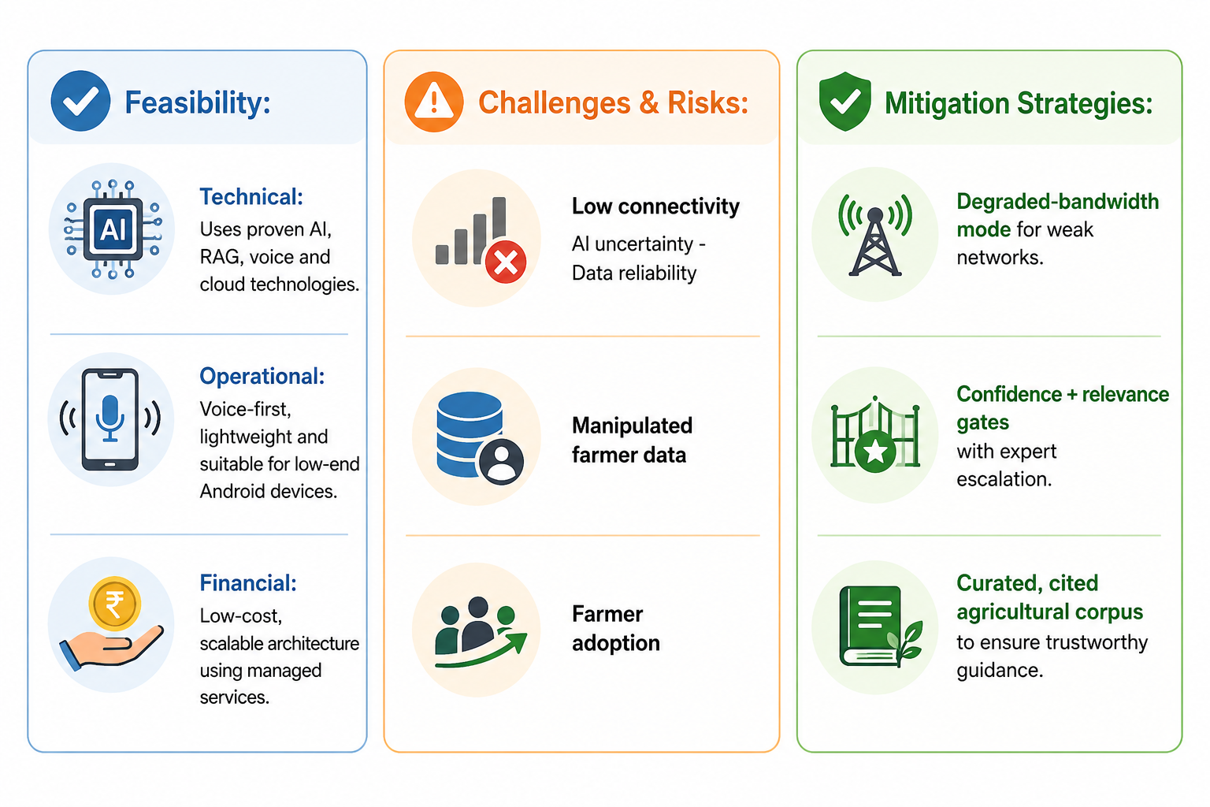
FEASIBILITY AND VIABILITY

Slide 5
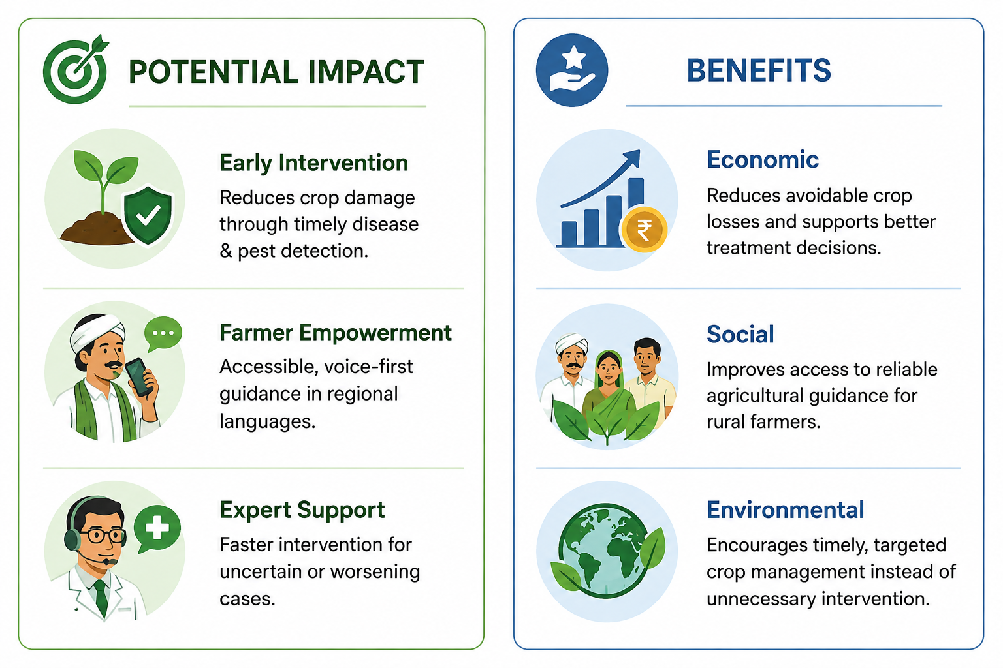
IMPACT AND BENEFITS

Slide 6
RESEARCH AND REFERENCES
1. Using Deep Learning for Image-Based Plant Disease Detection Mohanty, S. P., Hughes, D. P., & Salathé, M. (2016)
CNN-based plant disease detection using 54,306 images across 14 crops and 26 diseases.
Demonstrates the feasibility of smartphone-assisted crop disease diagnosis. Research Paper — Frontiers in Plant Science
2. Multi-level Learning Features for Automatic Classification of Field Crop Pests Xie, C., Wang, R., Zhang, J., et al. (2018)
Uses multi-level learning features for automatic field-crop pest classification.
Directly supports BHOOMI's pest-detection component. Research Paper — Computers and Electronics in Agriculture

